Slide 1

TO-DO-LIST APP
CS 499 – Senior project

Slide 2

PROJECT requirements
Solves a problem/makes life easier/improves something
Interesting and exciting
Involves research, discovery, and implementation of new IT/Software concepts

Slide 3

Solves a problem / makes life easier / improves something
To-do lists help users be more productive by preventing them from forgetting things, helping them prioritize tasks, manage duties successfully, make the best use of their time, and improving workflow.

Slide 4

Interesting and exciting
An app is a self-contained software package that allows users to perform specific tasks on a mobile or desktop device.

Slide 5

Involves research, discovery, and implementation of new IT / Software concepts
Users want a strong and complex development environment to create apps. App development software provides an environment that divides projects into workable components using organized code modules so that users may independently design, test, and debug those components.

Slide 6

TO-DO-LIST app
Introduction: To-Do List project is an application specially built to keep track of errands or tasks that need to be done. This application will be like a task keeper where the user would be able to enter the tasks that they need to do. Once they are done with their tasks, they can also remove them from the list.
Purpose: Using a to-do list enables users to mark off the task's users have completed. At the end of the day, when users look at the list, it will give users a sense of accomplishment and satisfaction. It might also have the effect of waking users up if nothing has been marked completed..
Scope: Organization of a proper work with an accurate planning of every task with its short description.
Technologies Used: Android Studio and Java

Slide 7

TO-DO-LIST app REQUIREMENTS
The system shall display all the products that can be configured.
The system shall allow user to select the product to configure.
The system shall display all the available components of the product to configure.
The system shall enable user to add one or more component to the configuration.
The system shall allow user to confirm the completion of current configuration.
The system shall enable user to enter the search text on the screen.
The system shall allow user to update the task information.
The system shall allow user to select the order from the order history.
The system shall display the detailed information about the selected order.

Slide 8
SCRUM
Scrum is a framework for project management that emphasizes teamwork, accountability and iterative progress toward a well-defined goal. The framework begins with a simple premise: Start with what can be seen or known. After that, track the progress and tweak, as necessary.

Slide 9
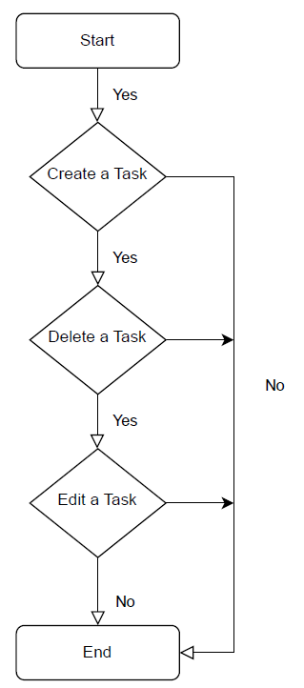
FUNCIONALITY DIAGRAM

Slide 10
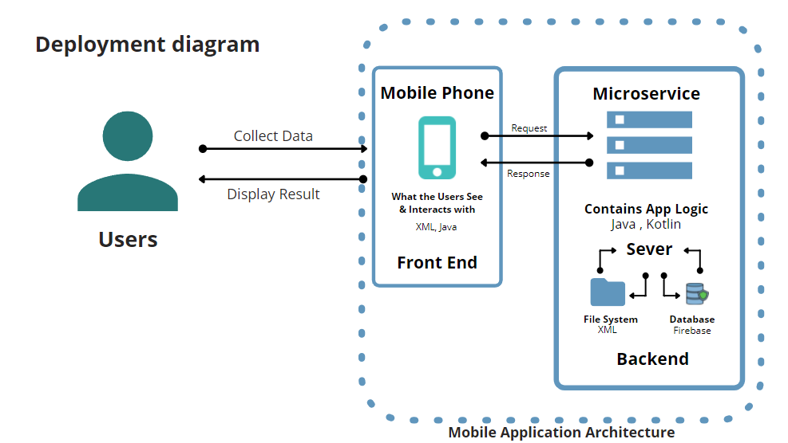
Conex ion diagram

Slide 11
Code

Slide 12

DEMO

Slide 13
Challenges / issues and what did I do about them.

Slide 14
Things I have learned, project highlights, and what would I do differently

Slide 15
RESOURCES
https://developer.android.com/guide/platform
https://www.w3schools.com/
https://www.youtube.com/@PenguinCoders

Slide 16

Thank you
PENELOPE SANCHEZ

